Slide 1
Driving Innovative IT Metrics By Embracing Human Nature
© 2017 Computer Aid, Inc.

Slide 2
John Bowen
Director – Global Partnerships, Computer Aid, Inc. – 2009-present
CIO – PPL Global - 1999-2009
President – Management Envision – 2012-present - research and consulting
Lived in Argentina and Chile for four years
Project management experience: Multinational projects in Latin America, Europe, Middle East, Asia, Africa 4-year project in US and UK (WMS, OMS, GIS, CIS, MMS)
5-year project in 8 companies in 5 countries (ERP, CIS, GIS, WMS, SCADA)
Education: DePauw University - Mathematics, Computer Science, Symbolic Logic
Visiting lecturer: Lehigh University, Iacocca Institute, Global Village,
Drexel University, DePauw University, DeSales University, Muhlenberg College –
Information Engineering, International IT, Global Business, Project/Program/Portfolio/Process Management
Notes:
I’ve been in the IT industry since the mid-1970’s. I’ve seen a lot of change over those 30+ years. But, more importantly…I have see a lot that HASN’T changed. We are still, as an industry, not managing our people and projects much better than we were in 1969 when the NATO report on software engineering (first time term was used) indicated that there were documented problems in Requirements, Design, Coding, Estimates, Monitoring Progress, and Communication. We are still an industry where the variation in individual performance is 26:1 and team performance is 6:1. And, Reliability (Bugs) is still a source of ‘credibility challenges’ with our customers.
Tom DeMarco in the book, Controlling Software Projects, notes, “So many software projects fail in some major way that we have had to redefine success to keep everyone from becoming despondent...”

Slide 3
Computer Aid, Inc.
Lehigh Valley, PA based privately-held corporation, founded in 1981
4,000+ employees: 6 continents, 15 countries
IT services: software solutions, application development, application maintenance, management consulting, system engineering, project/program/portfolio management, IT outsourcing, process engineering

Slide 4
Objective of Session
To establish the need for monitoring the metrics that really matter.
To identify why this is such a challenge.
To identify the types of metrics that really matter.
Show how familiar framework can be adapted for metrics identification (and communication).
Give you enough to use back at your office to improve your metrics program.

Slide 5
Agenda
The Innovative Metrics Opportunity
Why Do These Opportunities Still Exist?
What Metrics Should We Monitor?
Working With Conditions Data
Developing Innovative Metrics for Your Organization
Notes:
Our objective for this presentation is to enable you to be able to have a discussion with your people; your management and your staff, about innovating the management process. So, we’re going to talk about what is measured today…and what should be measured tomorrow. Obviously, from the performance data we have as an industry…we are not measuring the right things, and if we are, we’re not doing it very effectively.
This presentation is based on the premise that, “what gets measured, gets done.” The real question is, then, what should we measure, and how should we measure it? These are five topics that you probably already know a lot about, but are worth reinforcing.

Slide 6
Part One
The Innovative Metrics Opportunity
Notes:
Let’s take a moment to get a common understanding as to what ARE effective metrics.

Slide 7
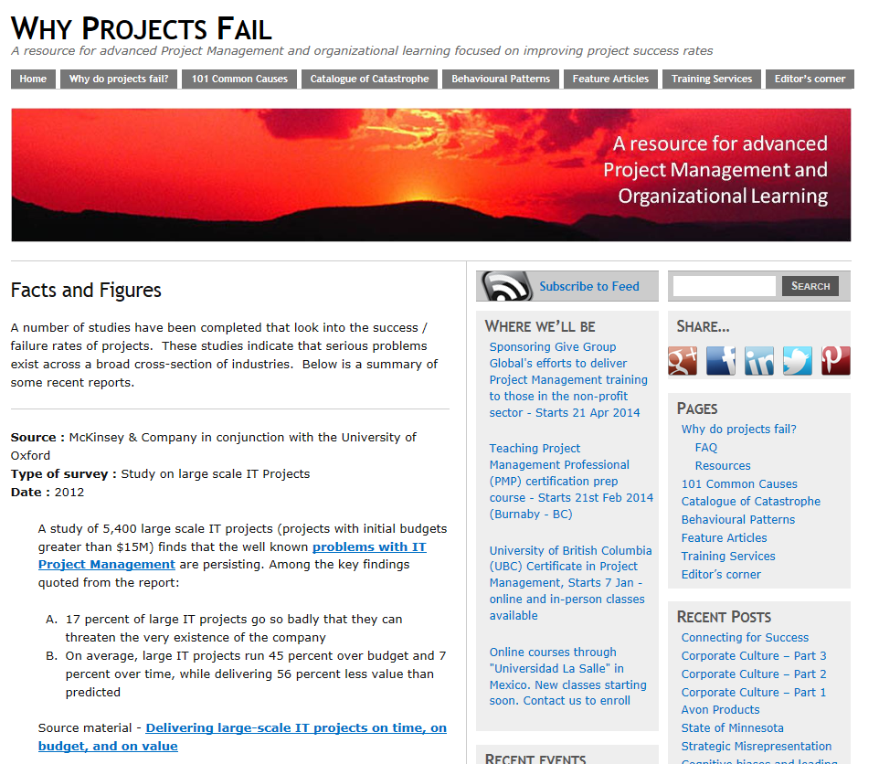
The Innovative Metrics Opportunity
Despite Everything We’ve Tried, Project Success Rates Little Changed in 30 Years
McKinsey (17% threaten company)
IBM (40% met exp 10X range)
KPMG (70% orgs with failure)
Standish CHAOS Report
Source: http://calleam.com/WTPF/?page_id=1445
“So many software projects fail in some major way that we have had to redefine success to keep everyone from becoming despondent...”
Source: Tom DeMarco in his book, Controlling Software Projects
Notes:
Source : McKinsey & Company in conjunction with the University of Oxford Type of survey : Study on large scale IT Projects Date : 2012
A study of 5,400 large scale IT projects (projects with initial budgets greater than $15M) finds that the well known problems with IT Project Management are persisting. Among the key findings quoted from the report:
17 percent of large IT projects go so badly that they can threaten the very existence of the company
On average, large IT projects run 45 percent over budget and 7 percent over time, while delivering 56 percent less value than predicted
Source material - Delivering large-scale IT projects on time, on budget, and on value
Source : IBM Type of survey : Survey of 1,500 change management executives Date : Oct 2008
IBM survey in the success / failure rates of “change” projects finds;
Only 40% of projects met schedule, budget and quality goals
Best organizations are 10 times more successful than worst organizations
Biggest barriers to success listed as people factors: Changing mindsets and attitudes – 58%. Corporate culture – 49%. Lack of senior management support – 32%.
Underestimation of complexity listed as a factor in 35% of projects
For source data read – Making change work
Source : KPMG (New Zealand) Type of survey : Survey of 100 businesses across a broad cross section of industries Date : Dec 2010
KPMG survey of Project Management practices in New Zealand finds some truly startling results;
Survey shows an incredible 70% of organizations have suffered at least one project failure in the prior 12 months!
50% of respondents also indicated that their project failed to consistently achieve what they set out to achieve!
Reference article - Most Business Experience Project Failure
Source material – KPMG Project Management Survey 2010

Slide 8
The Innovative Metrics Opportunity
There Is Plenty of Opportunity for Improving Challenged Project Success Rates
Source: http://versionone.com/assets/img/files/ChaosManifesto2013.pdf
Notes:
Even if we say that the 39% successful project doers don’t need us, and the 18% failures were doomed from the start…that still leaves 43% who are “challenged”. If just that is the market…it’s a huge market.
http://versionone.com/assets/img/files/ChaosManifesto2013.pdf

Slide 9
IT Project Management Success is Abysmal
US Dept of Defense Integrated Human Resource System (DIMHRS) Delivered no functionality; 199% original cost
UK’s Fire Control Project 11% functionality; 391% original cost
California Court Management System 10% functionality; 214% original cost
US Social Security Administration Disability Case Processing System No functionality; 100% original cost
British Columbia Integrated Case Management System 30% functionality; 100% original cost
Spectrum IEEE Org
9

Slide 10
The Innovative Metrics Opportunity
It’s About Competitive Capability
Organizations with a mature PMO outperform those with an immature PMO by:
28% for on-time project delivery;
24% for on-budget delivery; and
20% for meeting original goals and business intent of projects.
Source: www.metier.com, According to PMI
Notes:
Let’s not dwell on the negative (failure). Let’s focus on the positive…becoming more competitive.
Dramatic Opportunity:
Those organizations that HAVE developed mature project management offices have become more significantly more consistently reliable. Giving their organizations the ability to out-compete their rivals.
http://www.pmsolutions.com/audio/State_of_the_PMO_2012_Research_Report.pdf

Slide 11
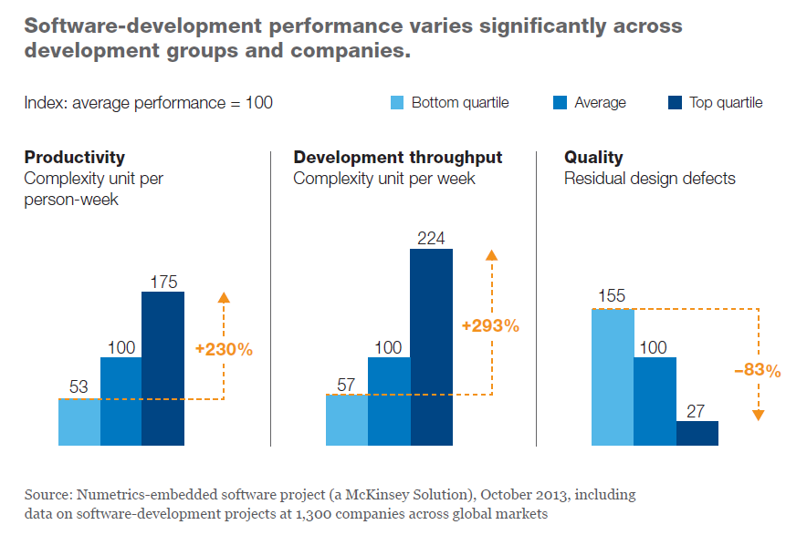
The Innovative Metrics Opportunity
It’s About Competitive Capability

Slide 12
The NEW Software Reality
“We believe that every industrial company will become a software company.”
Source: GE CEO, Jeffrey Immelt, 2013 GE Annual Report, Letter to shareholders.
It’s Happening NOW
Number of top 100 product and service companies - that are now dependent on software – has DOUBLED (to nearly 40%) in the past 20 years.
Revenues from digitized products and channels are expected to exceed 40% in industries such as insurance, retailing and logistics.

Slide 13
Part Two
Why Do These “Opportunities” Still Exist?
Notes:
As we said at the beginning of this presentation, we measure a LOT, but it doesn’t seem to materially impact our results. So, perhaps we aren’t measuring the right things, the right way.

Slide 14
Why Do These Opportunities Still Exist?
Self-deception
People (including PMs) are predisposed to see a perfect end state (e.g., successful project completion, and tend to practice self-deception (confirmation bias, fact filtering, etc.) to support this expectation.

Slide 15
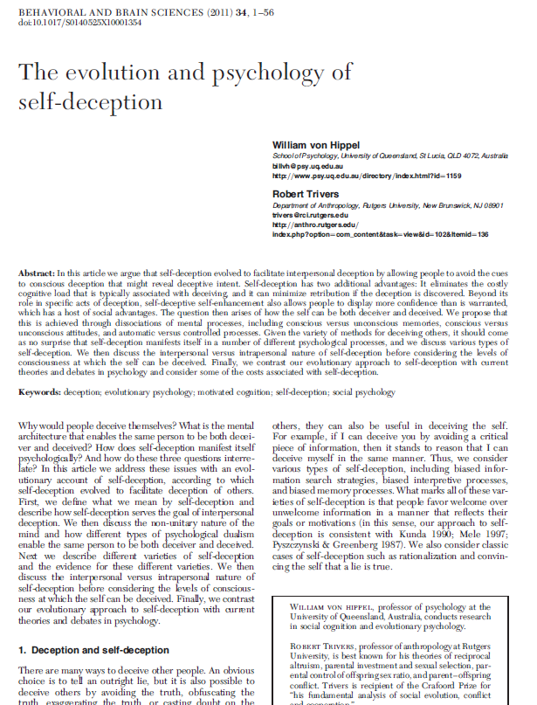
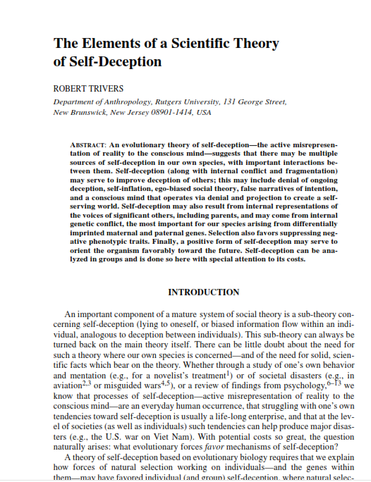
It’s Who We Are
Outside of IT for Neurophysiological Perspective
Anthropology Research
Psychology Research

Slide 16
Self-deception Is “Natural”
In fact, all humans self-deceive:
“self-deception is a kind of strategy which allows us to better deceive others by first deceiving ourselves…”
“self-deception occurs as a social intelligence strategy”
“there is a neuro-physiological basis for self-deception in humans.”
Paper by: James Sage, Ph.D, Vice Chancellor @ Univ. of Wisconsin
Research by: Robert Trivers, Ph.D, Evolutionary Biologist, Crafoord Prize recipient
Research by: V.S. Ramachandran, Ph.D, Neuroscientist, Center for Brain and Cognition

Slide 17
Quick Survey
How many people consider themselves to be above average drivers?
“For driving skills, 93% of the U.S. sample and 69% of the Swedish sample put themselves in the top 50%“
Svenson, Ola (February 1981). "Are We All Less Risky and More Skillful Than Our Fellow Drivers?". Acta Psychologica 47 (2): 143–148. doi:10.1016/0001-6918(81)90005-6.
“almost 80% of participants had evaluated themselves as being an above-average driver.”
Iain A. McCormick; Frank H. Walkey; Dianne E. Green (June 1986). "Comparative Perceptions of Driver Ability: A Confirmation and Expansion". Accident Analysis & Prevention 18 (3): 205–208. doi:10.1016/0001-4575(86)90004-7.

Slide 18
We Deceive Ourselves So As To Persuade Others of Our Worth
“A survey of university professors found that 94% thought they were better at their jobs than their average colleague”
“A survey of 1 Million high school seniors found that all thought they were above average [in their] ability to get along with others”
- Thomas Gilovich, 1993, How We Know What Isn’t So

Slide 19
The “Problem State” Takeaways
Stop expecting PMs to ‘do the right thing’.
Despite all the training and encouragement, PMs are still human and will tend to self-deceive (and then pass it on).
Make self deception impossible.
Provide PMs with timely, objective, action-compelling information.
Make ignoring important information impossible.
Provide PM management with information necessary to hold PMs accountable.

Slide 20
Project Manager Development Must Improve
“Successful projects are led, not managed.”
Great Project Management
20

Slide 21
Project Management | Project Leadership
Methodology | Leadership
Process | Communication
Project Plans | Tenacity
Status Reports | Focus
Project Meetings | Motivation
Software Skills | Inspiration
Time Tracking | Action
Issues Tracking | Energy
21

Slide 22
Part Three
What Metrics Should We Monitor?
Notes:
What IS this data?
The following section is going to focus on the measures you need to stay on top of no matter what industry you are in. They are not IT measures.

Slide 23
What Metrics Should We Monitor?
Backward Looking
Lagging Indicators
Tracking Progress
Forward Looking
Leading Indicators
Managing Risk
Notes:
It falls into two categories…
In the end, there are only two things that matter; am I making progress toward my objectives? And, am I managing the conditions that will determine future success (risks).

Slide 24
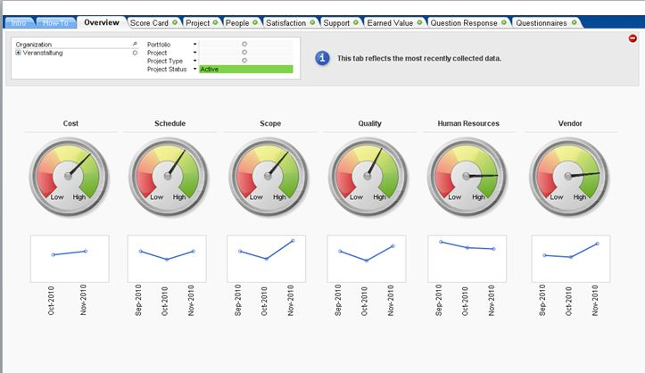
Tracking Progress Looking Backward
What did we do?
Volume
Quality
Cost
Notes:
We are great at collecting backward-looking data.
The basic data is what happened during a specified period of [past] time.
The “holy trinity’ of progress metrics; how many, how well, how much

Slide 25
Tracking Progress Looking Backward – Enterprise Level
Alignment of IT Investments to Business Strategy
Cumulative Business Value of IT Investment
IT Spend Ratio – New Versus Maintenance
Critical Business Services
Customer Satisfaction
Service Level Performance
Operational Health
Outages
Security Incidents
Project Success Rate
Average Defect Rate
Source: Craig Symons, Forrester Research, 4-4-08
Notes:
Even at the highest levels, the data that is monitored is ‘rear view’ data.
At the IT enterprise level, these are the core measures of value delivered and challenges addressed. All important. All rear-view metrics.

Slide 26
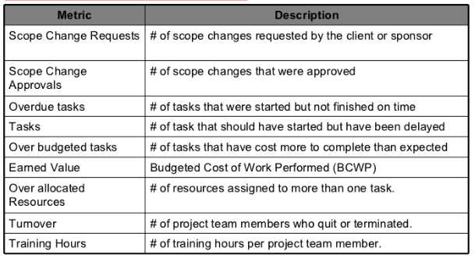
Tracking Progress Looking Backward – Project Level
http://www.slideshare.net/anandsubramaniam/project-metrics-measures
Notes:
These are typical rear view project management metrics. They are useful in predicting the future. If the number is bad then there is SOMETHING impacting results that could continue to impact future results. [The forward looking metrics ARE the somethings that do impact results.]
Results are symptoms.

Slide 27
Managing Risk Looking Forward – Experts Agree on EWS
What should we do?
Notes:
As these risk considerations apply to IT, here is some research-based validation.

Slide 28
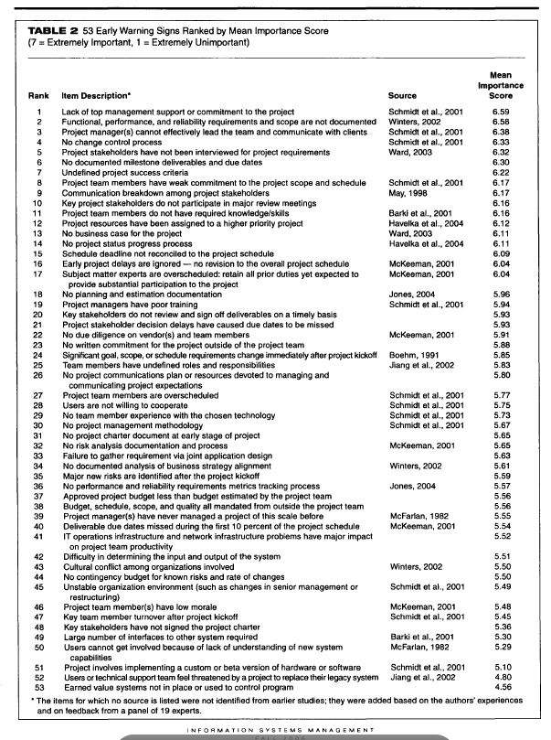
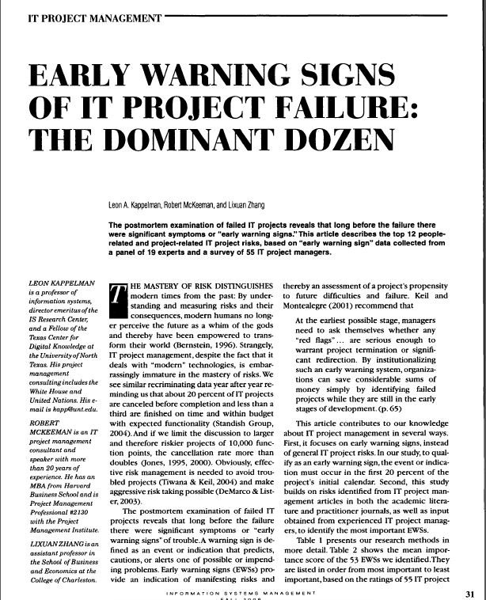
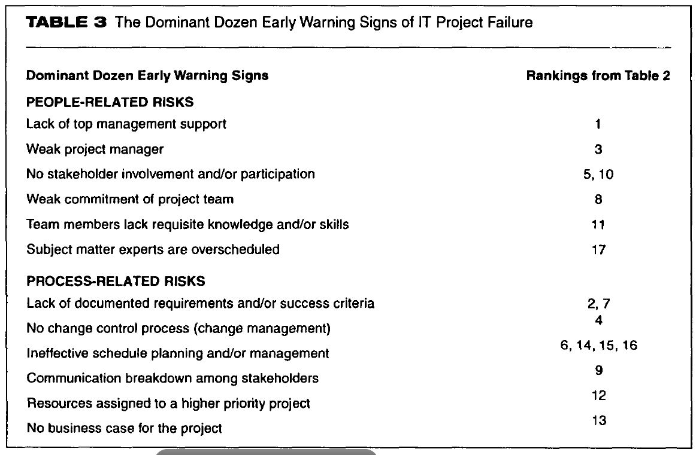
Managing Risk Looking Forward – Kappelman Research
Kappelman Research
Derived List of
Six People Factors
Six Process Factors
For In-process Audits
Notes:
Dr. Leon Kappelman conducted research. 55 PMs ranked a list of project failure causes extracted from exhaustive literature review. 54 Factors fell into two categories with six factors each.

Slide 29
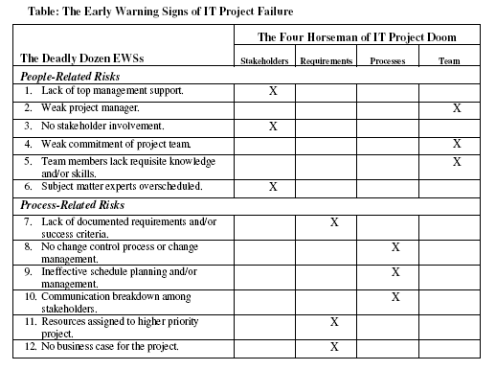
Managing Risk Looking Forward – Dominant Dozen

Slide 30
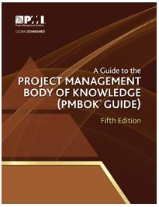
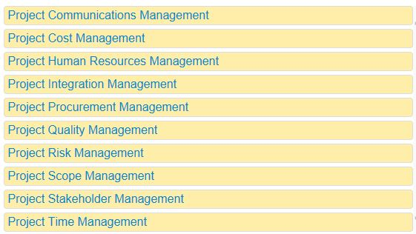
Managing Risk PMI Knowledge Areas
PM Competency Conditions
10 Knowledge Areas
Things You Should Know
Things You Should Do
Notes:
The Project Management Institute is the standards-making body for project management practice.

Slide 31
COMMUNICATIONS
MGT.
INTEGRATION
MGT.
RISK
MGT.
SCOPE
MGT.
POLITICS
STAKEHOLDER
MGT.
BUSINESS &
STRATEGY
CULTURE &
RELIGION
TIME
MGT.
METRICS
QUALITY
MGT.
PROJECT VALUE
MGT.
COST
MGT.
HUMAN
RESOURCE
MGT.
METRICS
PROCUREMENT
MGT.
Adapted from PMBOK® Guide – Fifth Edition, Figure 3-1, p. 61
31

Slide 32
The eight subjective (human) dimensions of Project Management - are responsible for 85% of all project failures (NASA study)
Time management (schedule)
Cost management (budget)
Scope management
Quality
Human resources
Risk
Procurement (contractors)
Integration
Communication
Stakeholder management
32

Slide 33
So, then…What Metrics Should We Monitor?
In addition to traditional
Key Performance Status
What To Collect
Key Performance Conditions
Intra-process Conditions
Inter-process Conditions
Key Process/Practice Compliance
Notes:
The conditions and process compliance data needs to be collected, too. Combined with performance status data, a true picture of project status and potential for success (areas that need attention) can be determined.

Slide 34
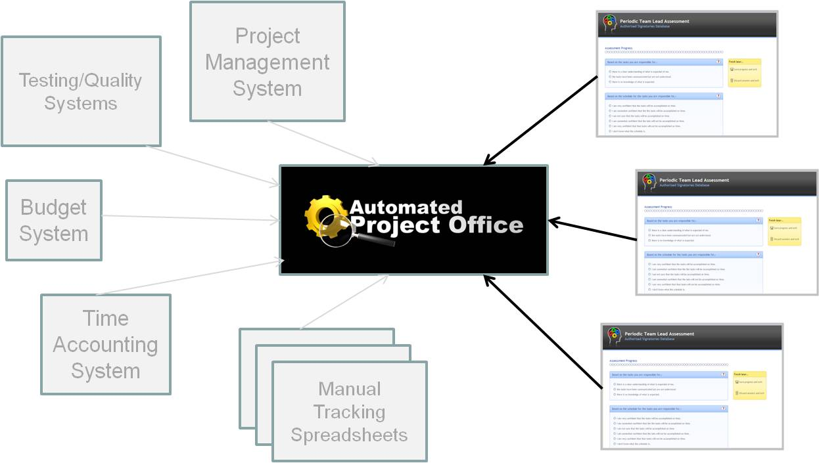
What Metrics Should We Monitor?
How to Collect the Metrics that Matter
Intuition
MBWA
Survey Software
Purpose Designed Software
Notes:
A lot of places still rely on ‘feel’. Others have semi-formal MBWA approaches. Some Situate teams together for a combination of both.
Others have systemized the process with surveys like Survey Monkey. Others. Like CAI have developed software expressly for capturing and combining the relevant project management data and providing managers with dashboards.

Slide 35
Part Four
Working with Conditions Data
(The Tale of the Four Missing Metrics)
Notes:
The following section is going to focus on the measures you need to stay on top of no matter what industry you are in. They are not IT measures.

Slide 36
Managing Risk You Need “ESP” to Know “PRP”
Three Important CONDITIONS to Monitor
Expectations Management
Sponsor Involvement
Process Compliance
To Minimize One Project Risk Factor
Project Rework Probability
According to the Carnegie Mellon Software Engineering Institute, “Data indicate that 60-80% of the cost of software development is in rework.”
Source: Paul D. Nielsen, “About Us: From Director and CEO Paul D. Nielsen,” Carnegie Mellon Software Engineering Institute, http://www.sei.cmu.edu/about/message/
Notes:
As the data at the beginning of the presentation indicates, we don’t do very well on managing risk. THESE are the conditions you should be keeping an eye on. These are the conditions that determine what the Vol/Qual/Cost outcomes will be.

Slide 37
The Four Missing Metrics
SMART – Are expectations clear?
SMPL – Is sponsor engaged?
PAL - Are processes being
followed?
PRPL – Are causes of
Rework being avoided?
Notes:
Here are some examples of measures that SHOULD be tracked, but almost never are. And, when they are, they are in response to situations that are already problems.
The do address the ‘holy trinity’ of measures; requirements clarity, sponsor involvement and process management. Together they address the ultimate metric, Rework Probability. Rework is at least 40% of ultimate project spend.

Slide 38
The SMART Level
SMART Level
Tracks the clarity of assignments. The higher the SMART Level, the higher the level of understanding of what is expected. Therefore, less Rework and less management intervention required.
The SMART Level
Notes:
This chart shows the SMART level within a set of control limits. Personally, I believe the control limits should be between 100 and 99.99. It’s almost a binary condition; either people get it, or they don’t. When they don’t they do their best to ‘fill in’ the missing pieces, often wasting ALL of the effort. But, that may be unreasonable standard. This 80-100 range is a good start.

Slide 39
The SMPL Line
SMPL Line
Tracks the participation level of the senior management and/or sponsor.
Senior Management Participation Level
Attention Needed
Notes:
Here’s the Senior Management (Sponsor Management) Participation Level. Looks like participation feel below the control limits a few times at the beginning of the project but has been pretty good lately.

Slide 40
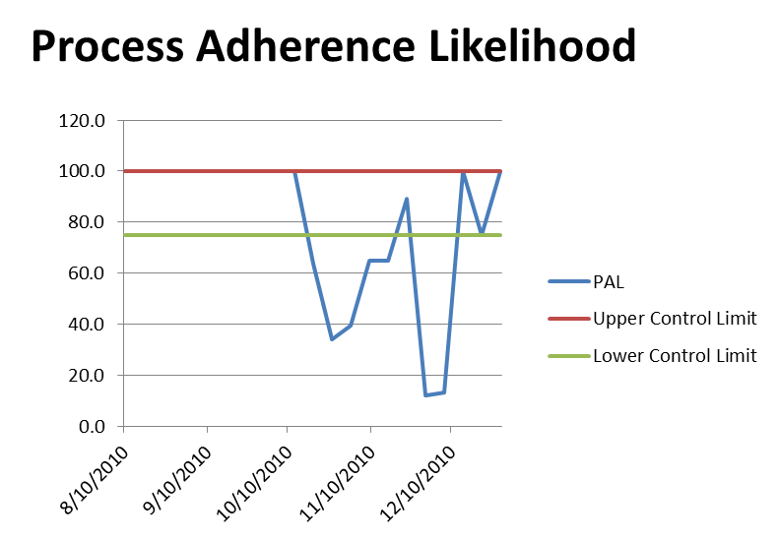
Process Adherence Likelihood
PAL
Measures likely level of process adherence based on conditions that would tend to lead to ‘short cuts’ on process..
Notes:
Process Adherence is key to success. It certainly is key to having a base for all of the other measures. If the process is not being followed, it can impact the SMART and SMPL lines. It may be the REASON people aren’t sure what they should be doing and why management isn’t participating.

Slide 41
The PRPL Line
PRPL Line
Tracks the ‘probability’ of Rework based on changes in the conditions that are known to cause Rework.
Project Rework Probability Level
Attention Needed
Notes:
When you take the requirements, sponsor and process measures together, you are able to predict the likelihood of rework.

Slide 42
Part Five
Developing Innovative Metrics for Your Organization
Notes:
Can’t cover every important metric here today. But, I will leave you with the ideal model to think about to determine the metrics you need.

Slide 43
How Did You Get Here?
In one of these?

Slide 44
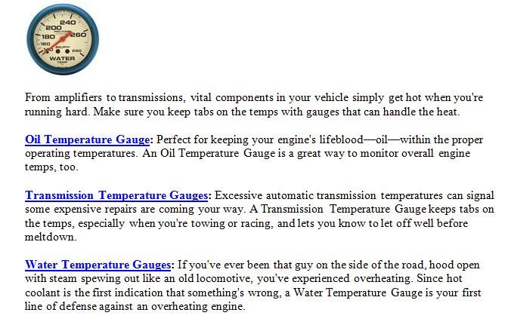
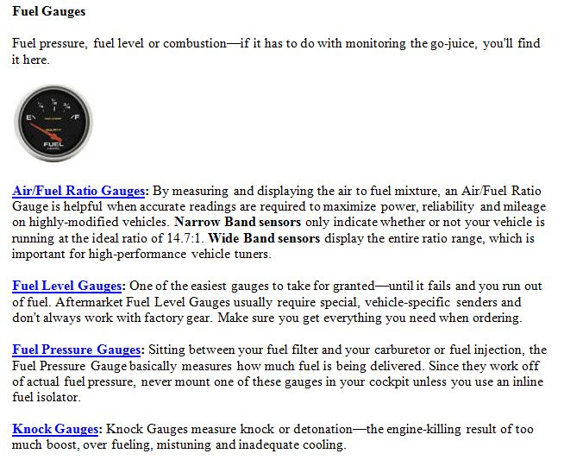
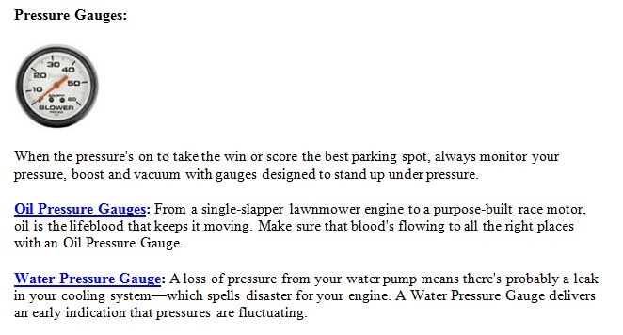
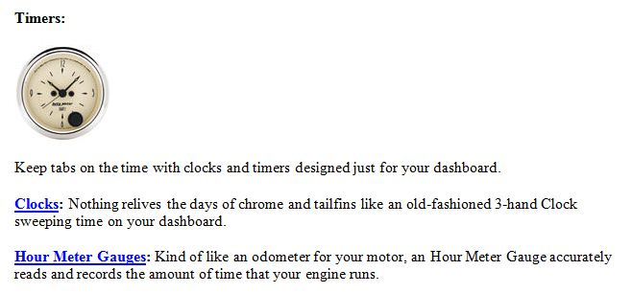
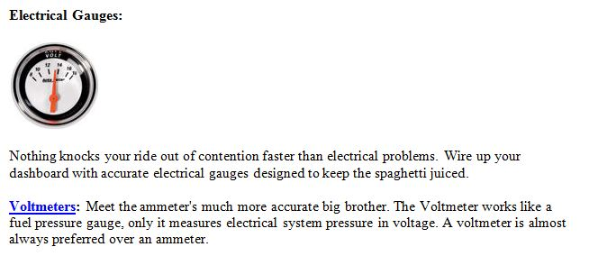
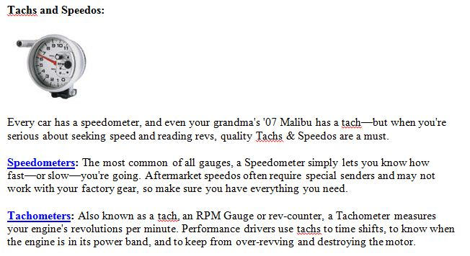
A Gauge for Every Condition
Automotive Engineers Long Ago Defined the Critical Measures for Safe, Effective Engine Operation.
Notes:
Nearly every possible measure of performance…and indicator of risk…has been identified for engines. A project IS an engine, too.

Slide 45
The Basic Measures
Automotive Gauge | Asks the Question | To Measure
Odometer | How far? | Deliverables Delivered
Clock | How long? | Duration
Fuel Level | How much further? | Input Units Available
Speedometer | How fast? | Deliverables per Unit of Time
Tachometer | How intensely? | Effort Intensity
Oil Pressure | Do we have enough lubrication to smooth interactions? | Supply of Lubricant to Smooth Interaction Between Components
Oil Temperature | How smooth are interactions? | Ability of Lubricant to smooth Interaction Between Components
Water Pressure | Do we have enough coolant to keep the engine producing? | Supply of Coolant to dissipate excess engine heat
Water Temperature | How effective is the coolant in keeping the engine cool? | Ability of Coolant to dissipate engine heat
Voltmeter | Is enough energy being applied to the other important systems? | Ability to Support other Control and Comfort Systems
Notes:
Here’s what is measured.

Slide 46
Comparative Metrics
To Measure | Automotive Metric | IT Metric
Deliverables Delivered | Miles | Milestones Met, Service Level Achieved, Function Point Delivered
Duration | Hour | Hour
Input Units Available | Gallons | Resource Hour
Deliverables per Unit of Time | Miles Per Hour | Earned Value Per Clock Hour
Effort Intensity | RPM | Hours Worked Per Week/Available Hours
Supply of Lubricant to Smooth Interaction Between Components | PSI | Stakeholder Interaction Satisfaction
Ability of Lubricant to Smooth Interaction Between Components | Degrees | Number of Open Issues from Stakeholder Interactions
Supply of Coolant to dissipate excess engine heat | PSI | Duration to Close Issues/Number of Issues
Ability of Coolant to dissipate engine heat | Degrees | Number of Escalated Issues
Ability to Support other Control and Comfort Systems | Volts | On Time Process Deliverables (Status, Reporting, Training)
Notes:
Analogous to IT measures.

Slide 47
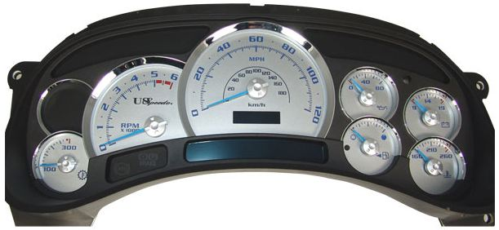
This is the State of PM Monitoring and Control Today
Notes:
The basic automotive dashboard can tell us a LOT about what we should be monitoring on our IT projects.

Slide 48
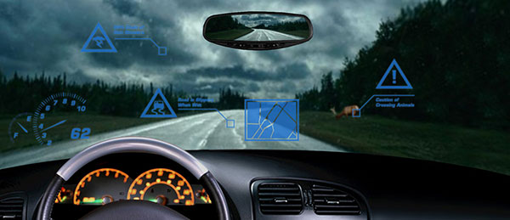
This is Where We Need to Be
Notes:
Of course, it can be much more complex. Just like our organizations.
Thanks and Good Luck.

Slide 49
Did We Accomplish Our Objectives?
To establish the need for monitoring the metrics that really matter.
To identify why this is such a challenge.
To identify the types of metrics that really matter.
Show how a familiar framework can be adapted for metrics identification (and communication).
Give you enough to use back at your office to improve your metrics program.

Slide 50
?
Questions
More information
John M. Bowen
Managing Director - International Partnerships
John_M_Bowen@Compaid.com
Phone: 610-530-5205
Mobile: 610-393-4425
Computer Aid, Inc.
1390 Ridgeview Drive
Allentown, PA 18104
www.compaid.com
50

